Slide 1
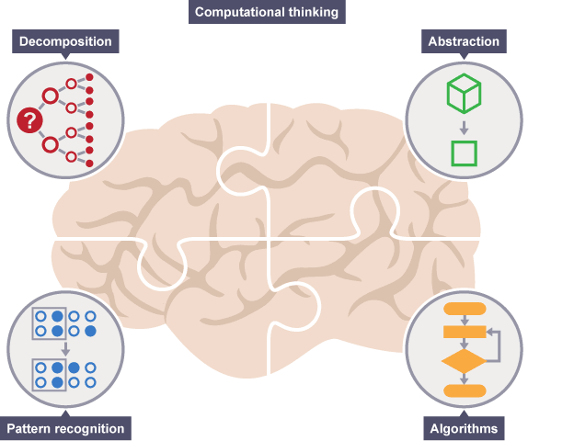
Computational Thinking in Everyday Life
Notes:
Resources:
https://www.bbc.com/education/guides/zp92mp3/revision/1
https://computationalthinkingcourse.withgoogle.com/unit

Slide 2

Lesson Objectives
Learn 15 mins
Know the building blocks of an algorithm
Apply algorithm in everyday activities
Activity 45 mins
Quiz 10 mins
Group Project
Solve an everyday problem using Computational Thinking

Slide 3

An algorithm is a set of
step-by-step instructions
to solve a problem.
How to Fold Clothes
We are using Algorithm everyday!

Slide 4
Example:- Algorithm from Real Life: Pizza Dough Recipe
Combine the bread flour, sugar, yeast and salt in the bowl of a mixer.
Start the mixer.
Add water and 2 tablespoons of oil.
Beat until the dough forms into a ball.
If the dough is sticky, add additional flour and beat.
If the dough is too dry, add additional water and beat.
Otherwise, stop and knead.

Slide 5
Example:- Algorithm from Real Life: Pizza Dough Recipe
Start
Combine the bread flour, sugar, yeast and salt in the bowl of a mixer
Start the mixer
Add water and 2 tablespoons of oil
Decisions / Conditions
Beat dough
...
Dough sticky?
Yes
Add flour
No
Dough dry?
Yes
Add water
No
No
Dough forms ball?
Repetitions / Loops
Yes
Stop
Starts knead process

Slide 6
Example:- Algorithm to find average numbers 1 - 10
Finding the average of numbers 1 – 10.
1. Set sum to 0
2. Set current_number to 1
3. Set sum to sum + current_number
4. If current_number is 10 then jump to step 6
5. Otherwise increment current_number by 1 and
jump to step 3
6. Set average to sum/10

Slide 7
Example:- Algorithm to find average numbers 1 - 10
sum
Start
current_number
Set sum to 0
average
Set current_number to 1
Set sum to sum + current_number
Decisions / Conditions
current_number is 10?
Yes
...
No
increment current_number by 1
Repetitions / Loops
Set average to sum/10
Set XXX to yyy
Stop
XXX
storage / Variables

Slide 8
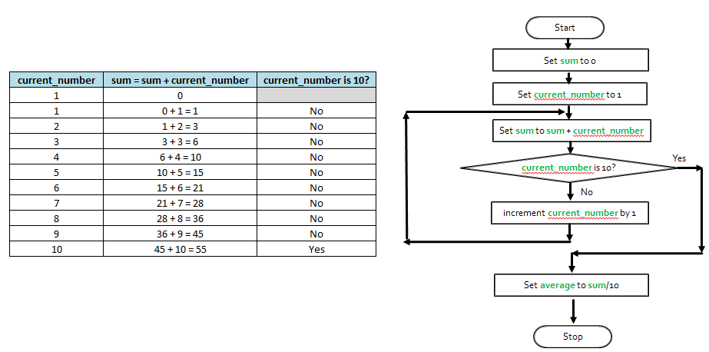
Example:- Algorithm to find average numbers 1 - 10
This repetition requires you to recognise a pattern in
order to come out with this algorithm

Slide 9
Example:- Algorithm for a Computer
Our average calculation algorithm is for numbers 1-10. However, we can do the same calculation for any range 1 .. n.
1. Set sum to 0
2. Set current_number to 1
3. Set sum to sum + current_number
4. If current_number is n then jump to step 6
5. Otherwise increment current_number by 1 and
jump to step 4
6. Set average to sum/n

Slide 10
Building Blocks of Alogorithm
Logical Operators
Conditional Statements
Loops

Slide 11
Logical Operators
And / Or / Not

Slide 12
Logical Operators
Logical operations in daily lives:
Buy broccoli AND carrots
Buy sugar OR honey
Do NOT buy peanuts (allergic!)

Slide 13
Logical Operators
Equal (==) – checks the trueness of the whole statement
E.g. the above programme check if the value is 5.

Slide 14
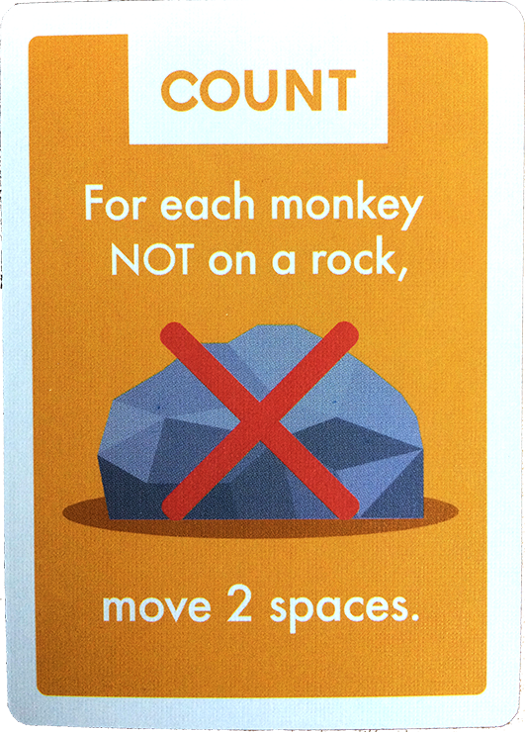
Logical Operators
NOT – flips the trueness or falseness of the whole statement
E.g. the above programme check if the value is not 5.

Slide 15
Conditionals
If … else

Slide 16
Conditional Statements
Conditional Statements + Logical operations in daily lives
“If bought sugar OR honey, we can go home and make our tea! Otherwise, we need to go back to store to complete the buy.”

Slide 17
Conditional Statements
Conditional Statements + Logical operations in daily lives
“If bought sugar AND honey, we can go home and make our tea! Otherwise, we need to go back to store to complete the buy.”

Slide 18
Conditional Statements
Conditional Statements + Logical operations in daily lives
“If did NOT buy nuts, go home! Otherwise,
go back to store to return the nuts!”

Slide 19
Loops
Loops allow us to repeat the same action every single time a condition is met, or until a condition is met

Slide 20
Loops
Loops allow us to repeat the same action every single time a condition is met, or until a condition is met
Two common types of loops:
For loop
While loop

Slide 21
Loops
Loops in daily lives
Making and eating a Peanut Butter Sandwich.
Take 2 slices of bread
For each ingredient (peanut butter & jam), use a knife to spread that ingredient on a slice of bread
Place one slice of bread on top of the other
Take one bite at a time until the sandwich is gone!

Slide 22
Example:- Algorithm to find average numbers 1 - 10
This repetition requires you to recognise a pattern in
order to come out with this algorithm

Slide 23
Loops
For loop – repeat a set of actions each time a condition is met

